Slide 1
AI Architecture and Project Plan
Zara AI
27/02/24

Slide 2





Current State
xx
Software +
On-Premise
Software +
On-Premise
On-Prem Configured Gen AI Solution
Cloud Based AWS Gen AI Solution
Progress made in building core LLM & LangChain functionality. Will be developed with a focus on security and robustness to cater to clients that are on-prem due, to security constraints or a low IT maturity.
Not started yet – but a faster build with existing services and reusable code from the on-prem solution. Require validation and approval on architecture before starting build.
Currently built on-prem LLM using Llama, hosted on Punjy’s computer, with a knowledge base and LangChain integrated
Creating/configuring AWS sandbox environment. Can spin up local instance for demo. Awaiting confirmation on international DREAMS access
Dockerised project and tested on different environment. Basic UI landing page and integration to knowledge base developed
Approved architecture and technology stack for first cloud demo – by cross referencing with client restrictions. Project plan and timelines approved
Understand Airforce security requirements – example of a different hosted on prem solution/application to understand it’s security constraints
First demo of Bedrock capability with RBAC on knowledge base and potentially** inline agent configuration by May 31st
Develop RAG Flow capabilities for on-prem solution by May 31st – Demo ready with knowledge base RBAC prioritised
Develop cloud hosted solution, with RBAC and AD groups configured by June 31st. Solution with multiple LLMS and a load balancer ready by July 31st

Slide 3
Development Priorities
xx
Developing an LLM that dynamically queries an organisational database for a seamless Generative AI experience, while adhering to Defences’ strict security requirements
01
Prioritise an enterprise-wide knowledge base model, with configured RBAC to customise the user experience
02
Prioritise scaling out the model with multiple LLM instances, a load balancer, and an appropriate access control framework
03
Prioritise logging, monitoring, and optimisation of compute and storage in the application through a continuous process
03
Build additional AI Agent features through system prompt engineering. Add additional bedrock features like In-line agents

Slide 4


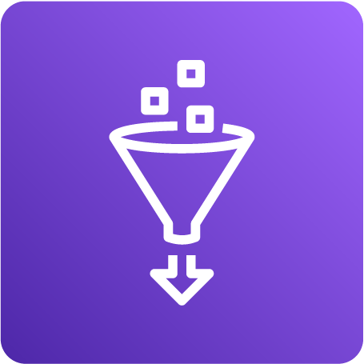










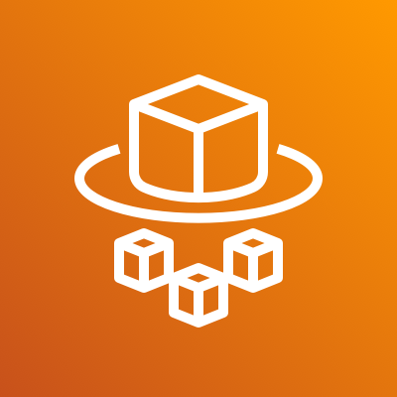








AWS Architecture
This is exclusively the data architecture. A number of these applications will be hosted on a VPC
SOURCES
INGESTION
LLM KNOWLEDGE BASE AND INVOCATION
APPLICATION HOSTING
LOGGING & DEVOPS
1
2
3
4
5
Objective
Content Manager
CloudWatch
Logging and Monitoring Services
AWS Glue For ETL
S3
File Upload
OpenSearch Serverless
Vector Database
DynamoDB Prompt Store and Chat History
AWS Bedrock
Knowledge Base
ECS Container Service
Flat Files
DMS Database Migration Services
Fargate Autoscaling and Load Balancing
CodePipeline
CI/CD and Version Control Capability
Database
AWS RDS
Relational Database
AWS Lambda LangChain & Action Groups
KENDRA
Image/Doc Search
6
Security
SSO
IAM
KMS
Secrets Manager
Security Hub
GuardDuty
1
Sample data for flat files and database. Possible third-party connector required for Objective
3
Storage of knowledge bases will sit on RDS for structured data, and S3 for all types of data. Bedrock will read from both for the knowledge base and automatically create an OpenSearch Serverless vector database. AWS Lambda will be used to invoke LangChain. Kendra will be used for searching unstructured sources.
4
DynamoDB/RDS will be used to store Prompts and Chat History. ECS will containerize the application, and Fargate will be used to auto scale the application and load balance with multiple LLMs
5
Logging will be done on CloudWatch, which integrates with all AWS services. CodePipeline
2
Ingestion will predominantly be done using Glue. Will build an example of an ingestion pattern using DMS, which is more efficient for larger use cases.
6
Full suite of security services will be integrated, to allow for a range of security requirements from the client

Slide 5
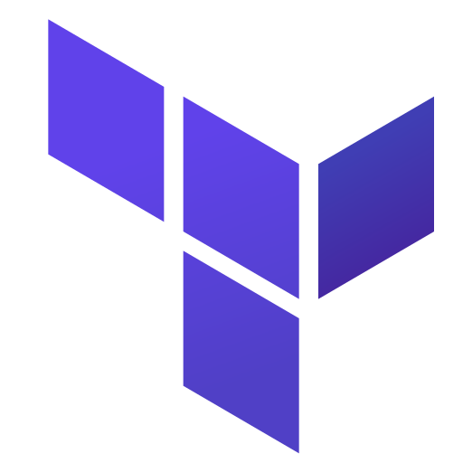








AWS Agentic Build
Poc capabilities
Open Search Vector Database
Knowledge base is configured separately and *associated* with an agent
All infrastructure is managed by Terraform, which will include a robust script for creation of collections, indexes, knowledge bases, agents, and after the session, the deletion of all of these resources
Ingested internally through data sync pipelines
Knowledge Base
Bedrock Agent
Agent Orchestration can be customised through 4 steps: Pre-Processing, Orchestration, KB response Generation, and Post-Processing. This can be parsed as Lambda functions, or with very targeted prompt engineering
Output
S3 Bucket with Source Files
User Query

Slide 6
API – creates KB, gets KB ID, does logging etc. Not used in query process. All other KB management tasks. Also all chat related activities, like saving chat history etc.
Containerised Build Draft
xx
Web
Minio
- Document Storage (s3 compatible)
Postgres – Relational Database
Ollama – Inference Engine
Identifying the plan/new prompt
New prompt is created based on chunk, original query The decision to summarise, or give a general option is done using the LLM
“based on <chunk>, summarise <query>” -- Also check if chat history is appropriate or not using LLM
KB ID and Document ID
Closest Chunk
Minio
- Document Storage (s3 compatible)
API
Keycloak
- Authentication and Login
Query
Web – Rest call to Pipelines
Pipelines
/query endpoint
Convert Query into vector point
Qdrant – Vector Database
Qdrant – Vector Database
Ollama – Inference Engine
Taskexecutor
Same Embedding model
RabbitMQ – Queue Manager
Postgres – Relational Database
Taskexecutor – After ingesting in file – an entry is made into PostGres, and a Queue entry is created. Task executor will fetch one item from the queue, and starts the indexing. Listens to RabbitMQ and starts the next process.
Only for file uploading process. Also uses Redis to maintain state of the document processing. This is then relayed to UI.
Pipelines
Valkey – Cache Manager (Redis equivalent)

Slide 7
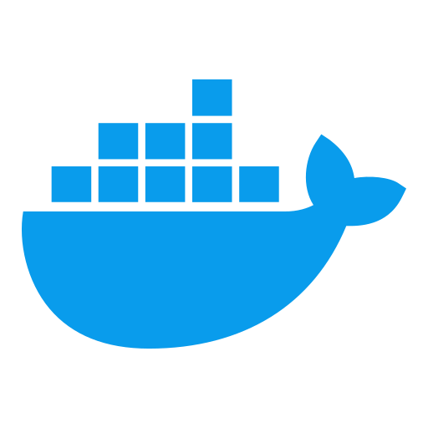



API Container Executes all knowledge base and chat management related activities
Minio Stores uploaded documents in full binary
Postgres Stores knowledge base and document metadata
Upload Document or Create Knowledge Base
Query
Web Container Hosts flutter frontend, and passes on requests to other containers
Pipelines Container Executes chat related tasks
User
Inside frontend
Ask Query

Slide 8

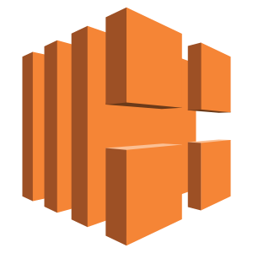
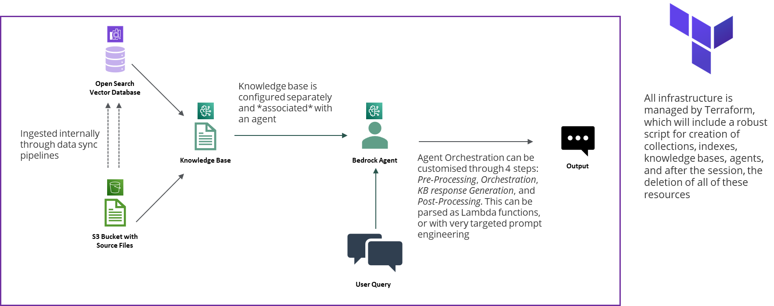

AWS Hosting Build
xx
User
Internet Gateway
AWS Virtual Private Cloud (VPC)
Availability Zone 1
Availability Zone 2
Public Subnet AZ1
Elastic Load Balancer
Public Subnet AZ2
Nat Gateway in AZ1
Application
Nat Gateway in AZ1
Private Subnet AZ1
Private Subnet AZ2
Security Group

Slide 9


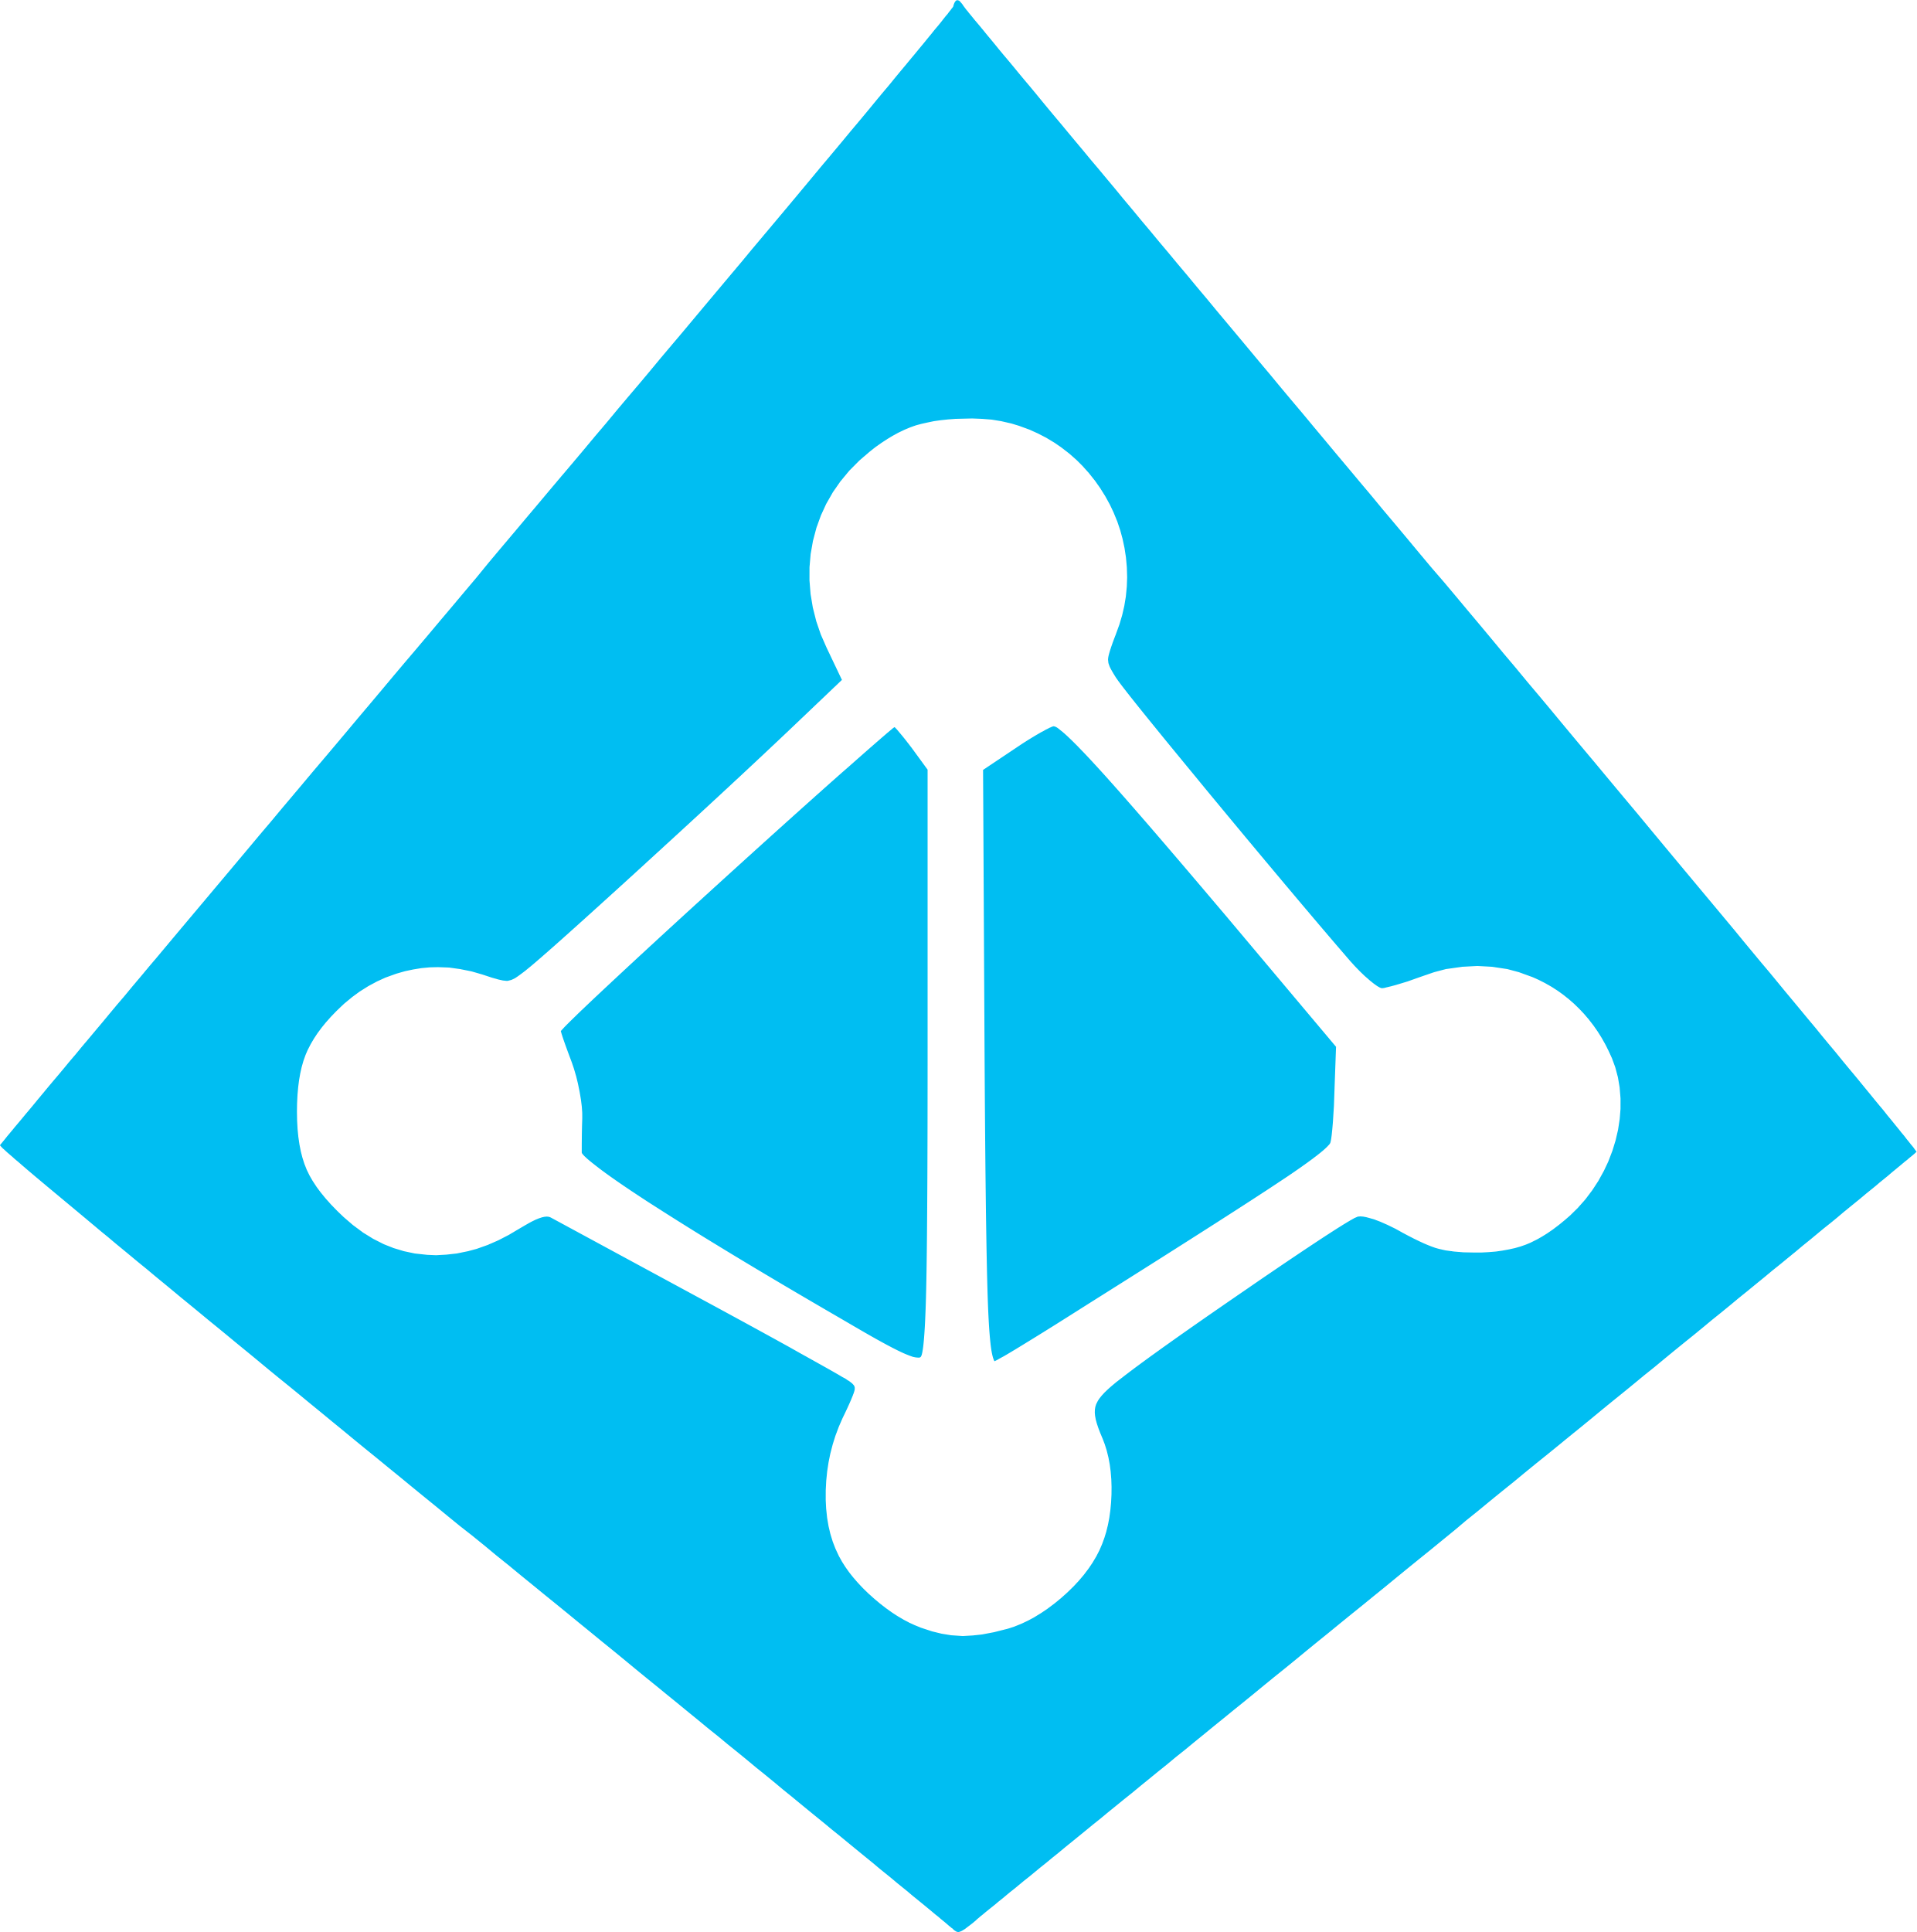






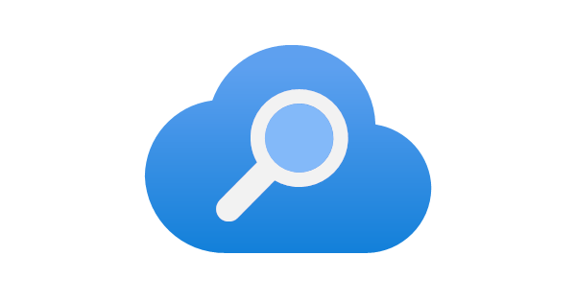

Production Build Architecture
xx
Tennant Layer
Tenant A
Separate User Management, Data Storage and Configurations
Tenant B
Separate User Management, Data Storage and Configurations
Tenant C
Separate User Management, Data Storage and Configurations
API Gateway
Layer
Will manage authentication and secrets management for access to APIs
Azure API Management
Azure Active Directory
Azure Key Vault
Infrastructure Layer
Will be built on an Azure best practices reference architecture, with containers deployed to Azure App Services, and Terraform to manage infrastructure
Azure Virtual Network and Subnets
Azure App Services
Azure DevOps
Data Layer
Files will be ingested from Objective through the approved API, and stored in ADLS Gen 2. Azure AI will be used to store and process the vector indexes
Objective Files
Azure Data Lake Storage
Azure AI Search
RAG AI Layer
Open AI will be used for the LLMs, and AI Search will be used for retrieval, with both vector and hybrid search.
Azure Open AI
Azure AI Search

Slide 10
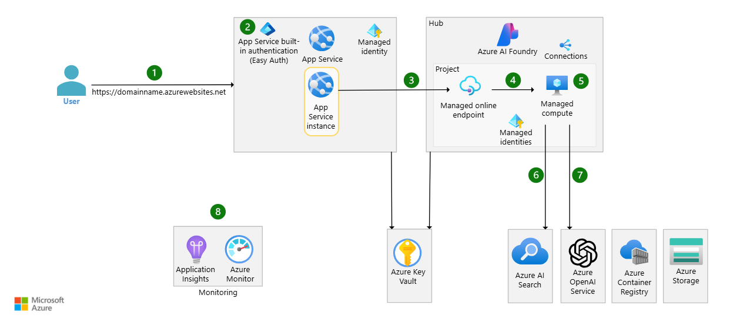

Slide 11
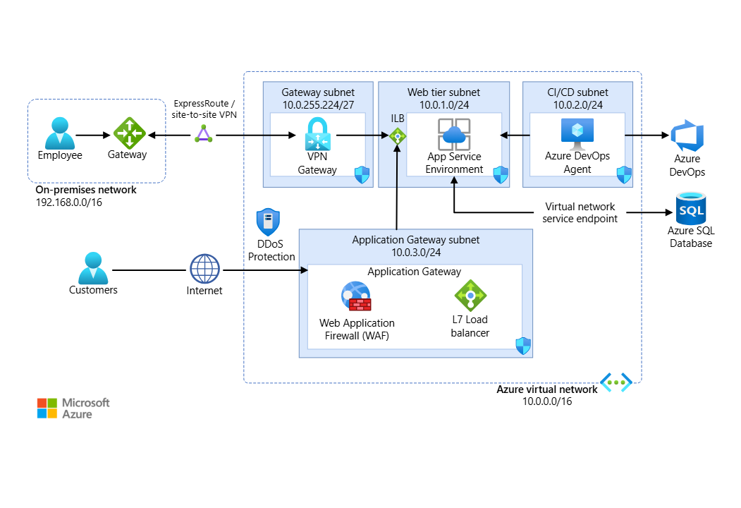

Slide 12


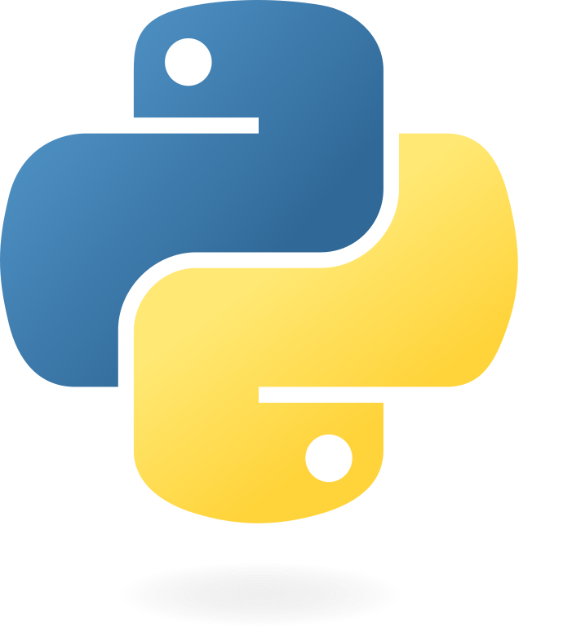
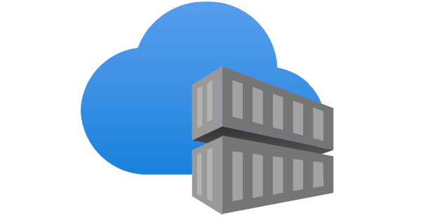


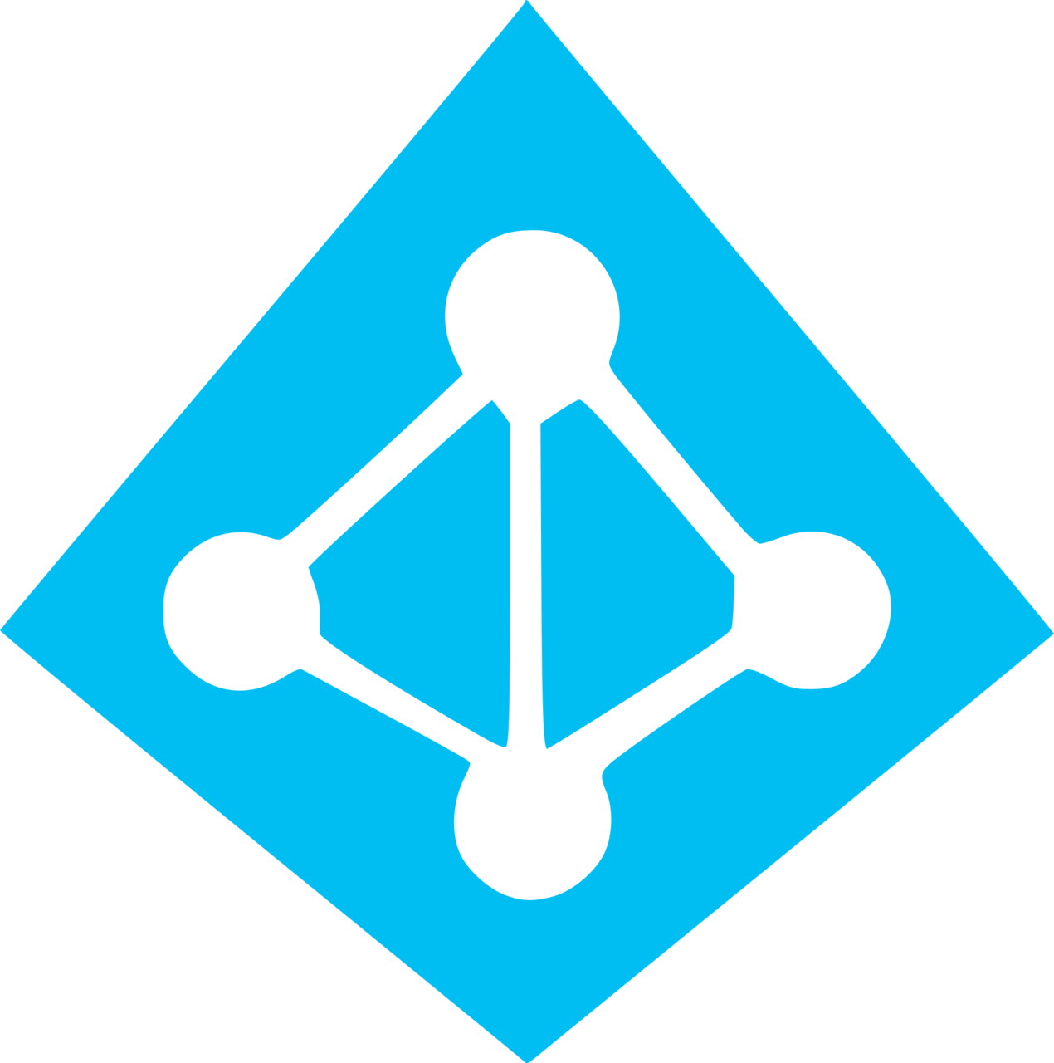
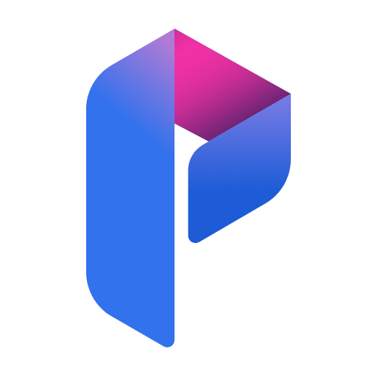

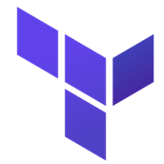




Version Control & CD/CD
Zara LM Source Code
Web Application Hosting
1
3
3
GitHub Version Control & Deployment
Azure Python SDK
SQL Database
Docker Containers (Microservice Architecture)
Azure Container Registry
For Deployment
Azure App Services
Azure Virtual Networks and Subnets
Azure Container Registry
Storing Docker Images
Landing Zone Architecture – different subscriptions for each component
Azure AD
Azure AI Search
Azure Prompt Flow
Azure OpenAI LLM
Compute and Hosting Layer
AI Search Layer
Data Storage Layer
Network Security Layer
Azure Data Lake Storage Gen 2
Terraform Infrastructure Managements
Open AI, AI Search, Prompt Flow
Blob, SQL Database
Vnets, Endpoints, Azure front door??
Azure Key Vault
App Services, ACR

Slide 13

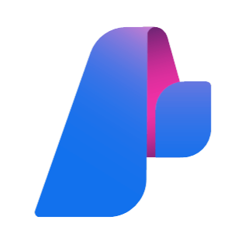


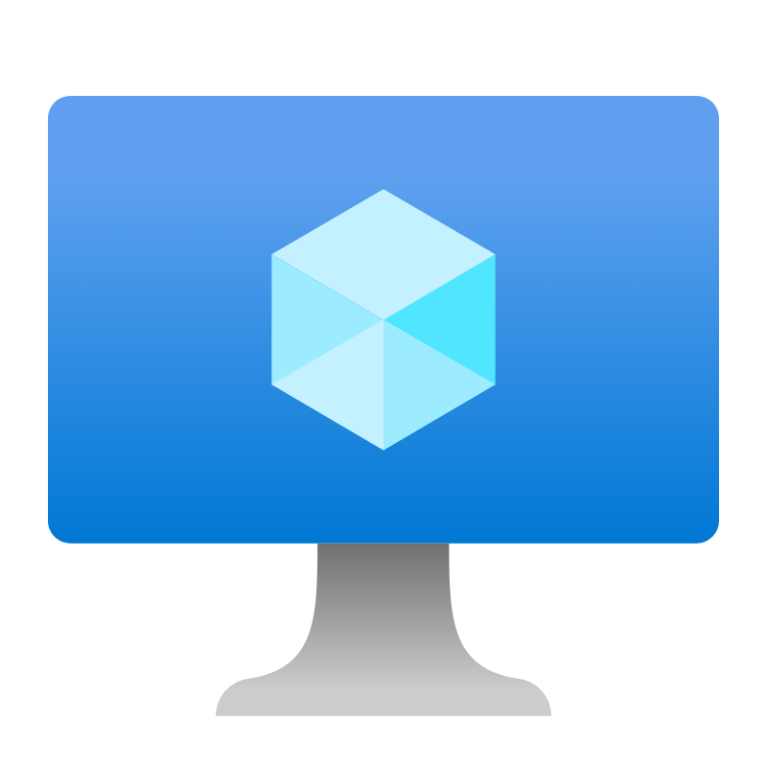


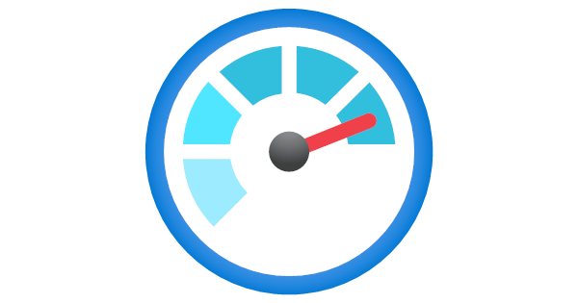



Azure Architecture
A RAG architecture centred around Azure AI Search Index’s
SOURCES
INGESTION
LLM KNOWLEDGE BASE AND INVOCATION
APPLICATION HOSTING
LOGGING & DEVOPS
1
2
3
4
5
Objective
Content Manager
Azure Python SDK
Azure AI Foundry
Custom Objective API**
SQL Database w/ SQL Server
Load Balancer
DevOps, for all CI/CD
Azure AI Search
Azure Prompt Flow
Azure OpenAI LLM
Azure VM
Or
Azure App Service
Flat Files
Azure Data Factory
Azure Data Lake Storage Gen 2
Azure Monitor
Database
6
Security
KeyVault
Microsoft Defender
Entra ID
1
Sample data for flat files and database. Possible third-party API connector required for Objective
3
Storage of knowledge bases will sit on a SQL database for structured data, and ADLS Gen 2 for all types of data. On these, an AI Search index will be created with a semantic configuration. This AI search, along with prompt flow functions, will feed the necessary knowledge base to the Open AI LLMs.
4
Currently, no hosting decision has been made. This will require input from client on their preferred networking and hosting requirements. Once an instance is hosted, scaling up will require a load balancer to ensure sufficient distribution of compute services.
5
Logging will be done with Azure Monitor, and all CI/CD practices will be managed by Azure DevOp.
2
Ingestion will be done using ADF pipelines, with attachment of notebooks if any transformation are required.
6
Full suite of security services can be integrated, but client input is needed to meet their requirements

Slide 14
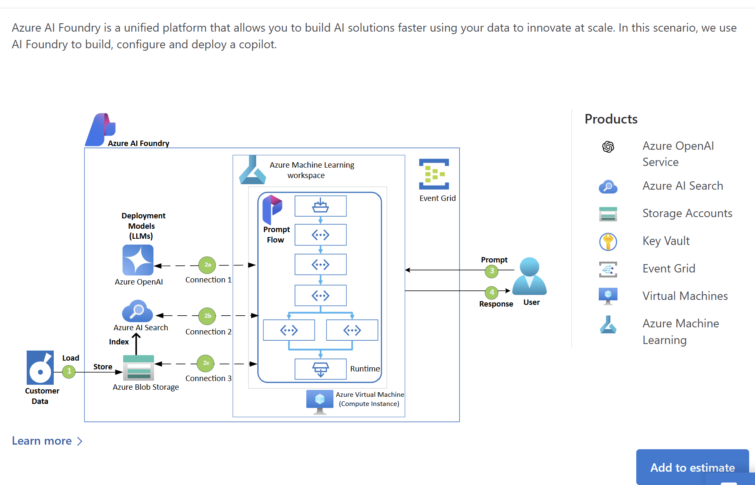
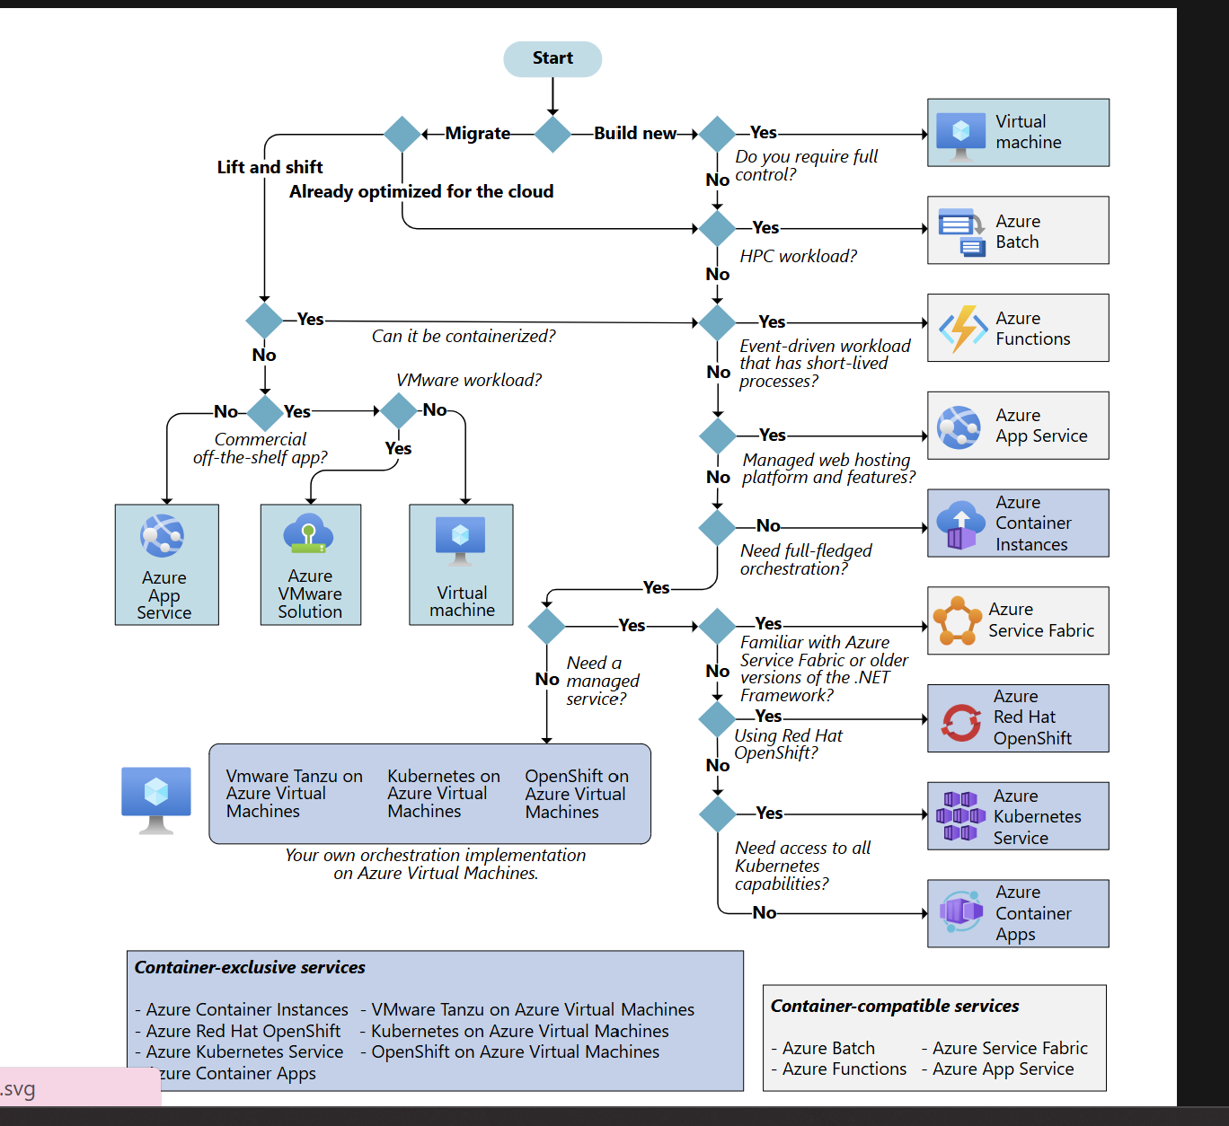

Azure Images
Details for Azure hosting

Slide 15




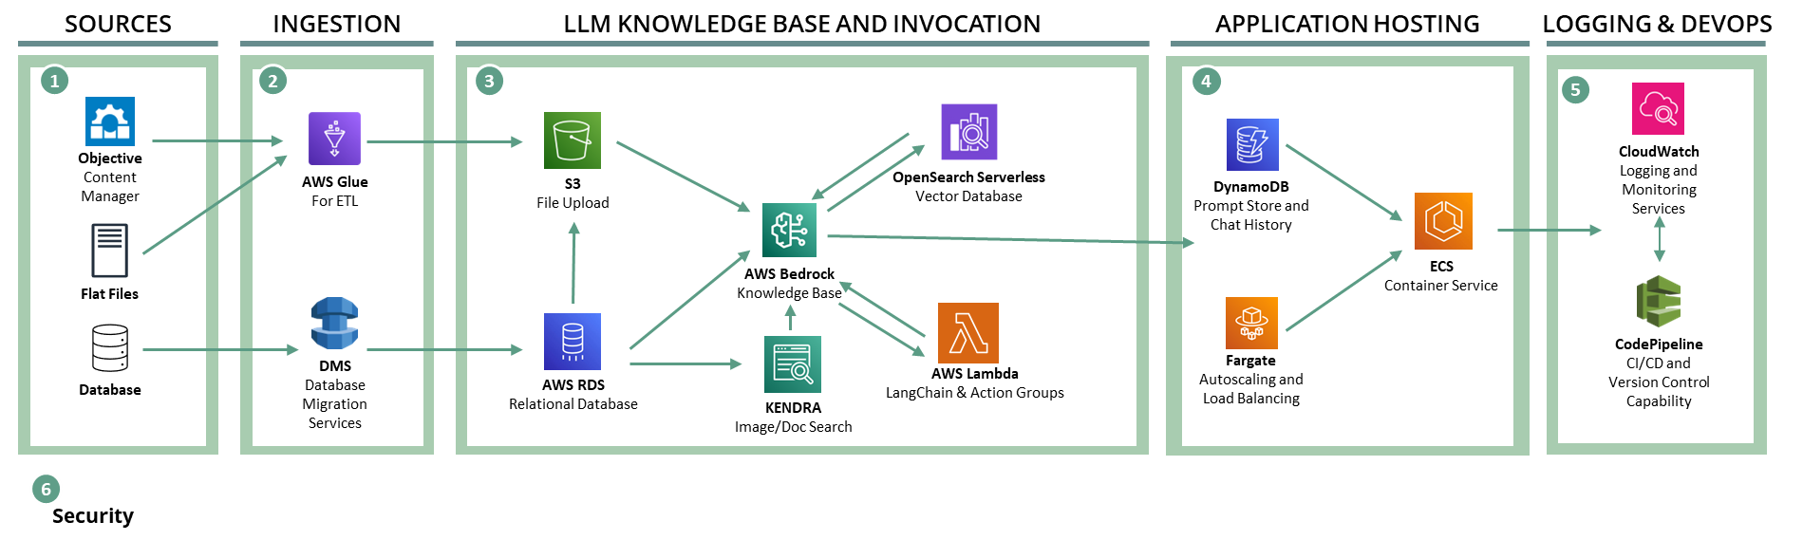
Platform Architecture – Require more assistance
Developing a SaaS application on Cloud
VPC
Glue Job
Online Database
NAT Gateway
S3 Data Lake setup for different clients
Public Subnet
Data Architecture
VPN + Virtual Gateway, and an on-prem Gateway
EC2 – VM Compute
Client 1 VPC
Client 2 VPC
Private Subnet
Network VPC
On Prem Database
SSO
IAM
KMS
Secrets Manager
Security Policies and Configurations

Slide 16


On Prem Architecture Diagram
xx
Architecture
Approach with RAG Flow
Our utilisation of RAG Flow will be used to populate AWS Lamba for LLM capabilities using serverless functions.
Will also lift and shift UI. If application can be hosted via a VM, we can use the same front-end framework. Before we do this, we need to decide how to host the architecture.
Potentially Not Needed Need to Confirm
Challenges about Security Knowledge for both Cloud & On-Prem

Slide 17

Timeline Slide
Activities are an initial estimate of workload – which may change once we start building capability on AWS. Require sign off on Demo and Output dates
March | April | May | June | July | August
Legend
On Prem Solution Demo
Basic Capabilities Demo
Full Demo
Phase
Preparation
Have a functioning Bedrock LLM with RBAC on dummy data in S3
Activity
Start Cloud Development
Output
Build
Demo RAG Flow Capabilities
Get Environment
Develop Cloud LLM with full security suite, ECS containerised UI, and all core Rag Flow features
Full AWS Generative AI Solution
Demos
Spin up required resources
Utilise full Bedrock capabilities
Implement Robust Security Model
Create UI and host application using appropriate services
Start preparing for scaling out with multiple LLMs and a load balancer
Start developing logging and monitoring capabilities
Create dummy data and warehouse
Start integrating on premise solutions where applicable
Note: Difficult to estimate activities without further research and guidance from Preparation Phase
Document
Documentation of Solution
Package solution for demo and develop documentation
Continue gathering client requirements to implement for the demo
Develop handover and package application in line with Phoenix Solution standards

Slide 18
Week 08/06 – 15/06 | Week 15/06 – 22/06 | Week 22/06 – 29/06 | Week 29/06 – 05/07 | Week 05/07 – 12-07 | Week 12/07 – 19/07
On Prem Solution Demo
Azure MVP Demo
Finalise remaining UI and chat enhancement
Test solution – All hands
Scope Reporting Use Case
Develop and Build Implementation Use Case
@punjaya – activities here
@Everyone Test on-premise deployment for Windows, Linux and Mac
@punjaya – activities here
@punjaya – activities here
@Everyone Test website Azure/AWS
Sign off on design and technology
Lockdown build approach
Build Azure MVP
@Vudaya to sign off on design with Ed and Defence team
@Everyone Whiteboard session on fastest way to flip front end and back end python into Azure SDK python
@Sam to familiarise with Bicep as an IAC tool, and prepare for microservice to CLI deployment approach
@Sam start creating infrastructure on Azure, build repository and copy folder structure of the on-prem solution
Finalise Testing Data Sets
Continue Eval Pipeline Work
Implement on LangSmith
@Dwarak build out rest of the data sets with feedback from @Punjaya and @Sam
@Dwarak @Sam build out client-ready testing documentation
@Dwarak @Sam get comfortable with LangSmith

Slide 19
Cadence
xx
Requirements | Notes, Options & Suggestions
Standup with John & Matt | Option 1: 1 hour in-detail meeting once a week, mini sprint showcase and plan Option 2: 15 minutes daily meeting to capture plan, progress and any blockers
Time with Vijay Uncle | Showing capability and progress – more frequently in the lead-up to May 31st Demo. Potentially once a fortnight?
Role of Matt & John | Option 1: Project Managers, who will assign us work daily or weekly and manage timelines to meet demos. The overall vision of the application will be their responsibility. Option 2: Fellow developers, so we split work 4-ways, and all share equal responsibility for the planning, developing and execution of Zara AI Option 3: Technical advisors, who will roughly monitor our progress. We will use them to alleviate blockers and ask specific questions, but we will manage our own timelines for the demos.
Client documentation and IP | We need more resources and templates for cloud implementation in defence. Particularly from a platform setup perspective on DAWS
Platform Engineering & Security Assistance | We would love access to all Phoenix employees, so we can soundboard ideas for specific capability

Slide 20


Slide 21


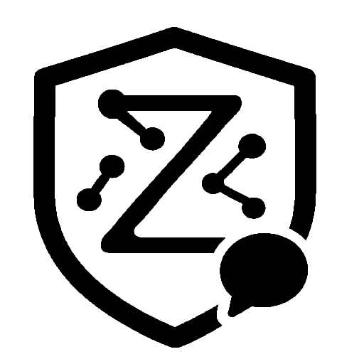




3x
3x
Acquisition Project Report
Product Performance Report
ZaraLM Processes Data and Generates Insights
Download Annex A, Annex B, QPR and supplementary docs
Previous QPR for template and structure
Next Phase of Work
Stakeholder Feedback and Refinement of Annexe A and B

Slide 22






DATA PROCESSING
INFORMATION EXTRACTION
REPORT PREPARATION
REPORT GENERATION
QA Analysis agent extracts text-based insights from Json’s
Report Generation Agent uses insights from QA and Data Analytics agent to form reporting outputs
3x APR and PPRs are parsed and processed into Json's for structured storage
Reporting text and visualisations are formatted and rendered on an editable .docx
Data Analytics agent extracts statistical insights from Json’s
Visualisation module will use the Data Analytics agent to create pre-coded visuals

Slide 23
Timeline Slide for V2
Feel free to make any changes Punjy
14-16th November | 16-18th November | 18-20th November | 20-22nd November | 22-24th Novermber | 24-26th Novermber | 26-28th November | 28-30th November
V2 Timeline for the rest of November
Retrieval System
Finish first retrieval system & integrate with V2 pipeline
Fine tune final react agent performance – testing with a number scenarios to see if the right tool is used
Build in metadata into ingestion, so Qdrant use case can follow the same routing agents as the Elastic use case
Test via Eval Pipeline and tweak both use cases accordingly. Prioritise Qdrant use case and focus on getting agent-logs to handle longer latency
Eval Pipeline
Connect Eval Pipeline up to V2 end-to-end so it can be compared to V1 with existing metrics
Finalise volume testing, and set up offline Elastic DB for Elastic Use Case testing
Design evaluation tests for any subsystems within the different components of V2 e.g. a query processing eval test, a retrieval eval test, and a final generation eval test
Run Evaluations and analyse the root cause of poor performance so the developers can tackle issues
UI Changes
UI Change for Human In the Loop validation
UI Addition for rendering chain-of-thought/agent logs
End to end build
Finalise query processing and final generation subsystems with critiquing agents
Focus on latency management, parallelising/optimising LLM calls and monitoring memory
Prepare for Deployment

Slide 24




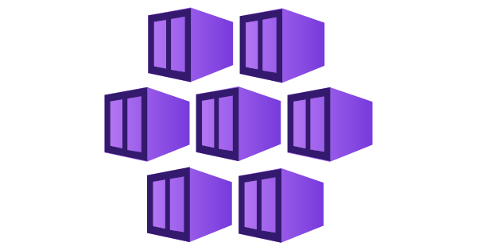
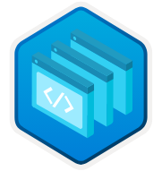




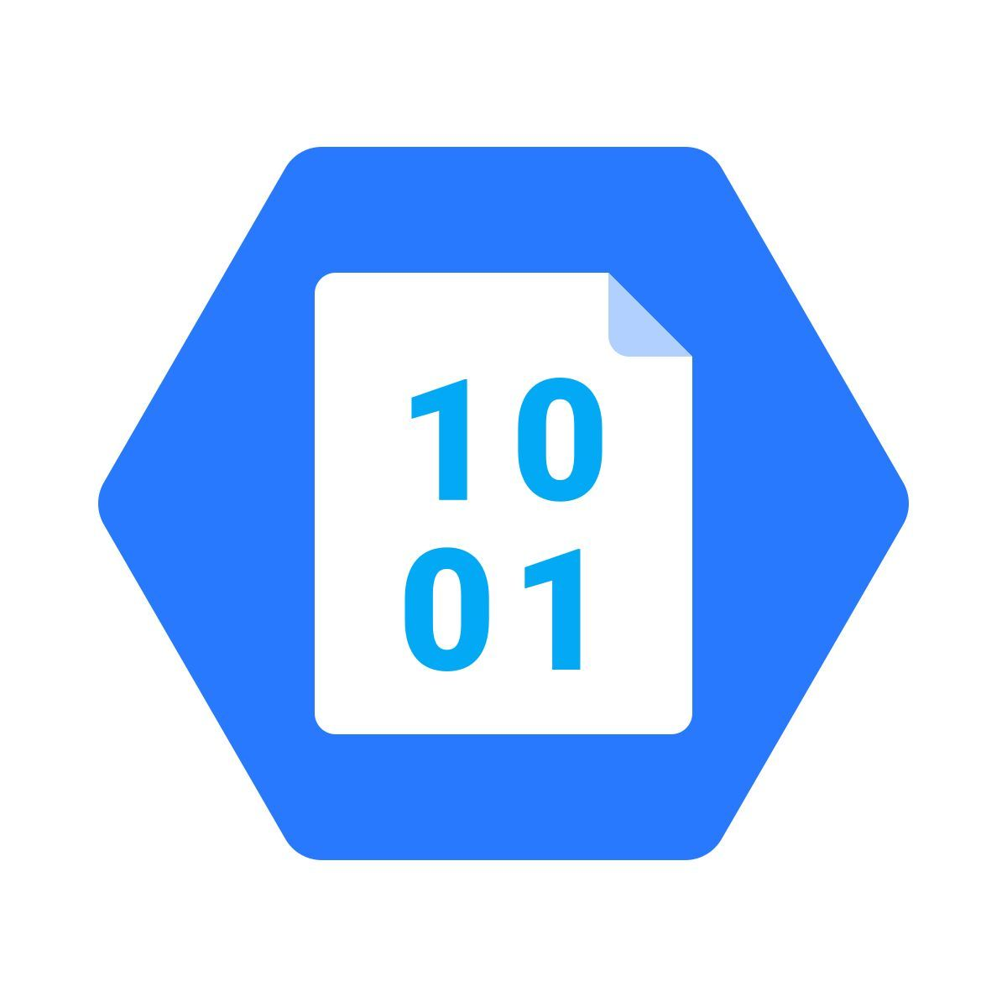

Azure Diagram
Current Zara Azure deployment technology stack
CI/CD
Zara LM Source Code
Application
Azure Virtual Networks and Subnets
DevOps
Version Control & Deployment
Cosmos DB using MongoDB vCore
Vector Database
Bicep Template
Infrastructure as Code
Azure Kubernetes
Container Orchestration for Scaling
Python with
Azure CLI
Docker Container
Static Web Apps
Frontend Deployment w/ Node.js and React
Azure Container Registry
Storing Docker Images
Azure Functions
All API endpoints
Ollama
LLM & Embedding Models
Entra ID
Authentication
Blob Storage
Document Storage
Blob Storage
Metadata Storage
User Uploads Document

Slide 25

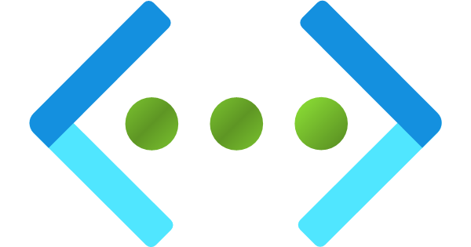





Zara AI Networking Design
Public Frontend
Azure Build
User Sends Query
Azure Virtual Network
10.0.0.0/16
Subnets
Kubernetes
Embedding Func
Doc Processor
Ollama Query
PUBLIC SERVICES
10.0.0.0/20
Kubernetes Nodes + Ollama pods. Receives image from ACR via a private endpoint. Connects to Azure Functions when Ollama or embedding endpoints are called
10.0.16.128/26
VNet Integration (Outbound)
Azure functions endpoint for embedding documents into Cosmos DB, and searching documents based on a query.
10.0.16.64/26
VNet Integration (Outbound)
Azure functions endpoint for storing documents and metadata in blob storage
10.0.16.0/26
User Facing API
VNet Integration (Outbound) + Public (Inbound)
Azure functions endpoint for calling models in Ollama to generate a response
VNET INTEGRATION
PRIVATE ENDPOINTS
Container Registry
Cosmos DB
Blob Storage
Azure Functions
10.0.17.0/28
Storage for Ollama image, private endpoint disables public access
10.0.17.16/28
Vector database (MongoDB vCore), private endpoint - internet blocked
10.0.17.32/28
Document storage + Function App files, private endpoint - internet blocked
10.0.17.48/28
Private endpoints for Doc Processor & Embedding functions - only callable from VNet

Slide 26

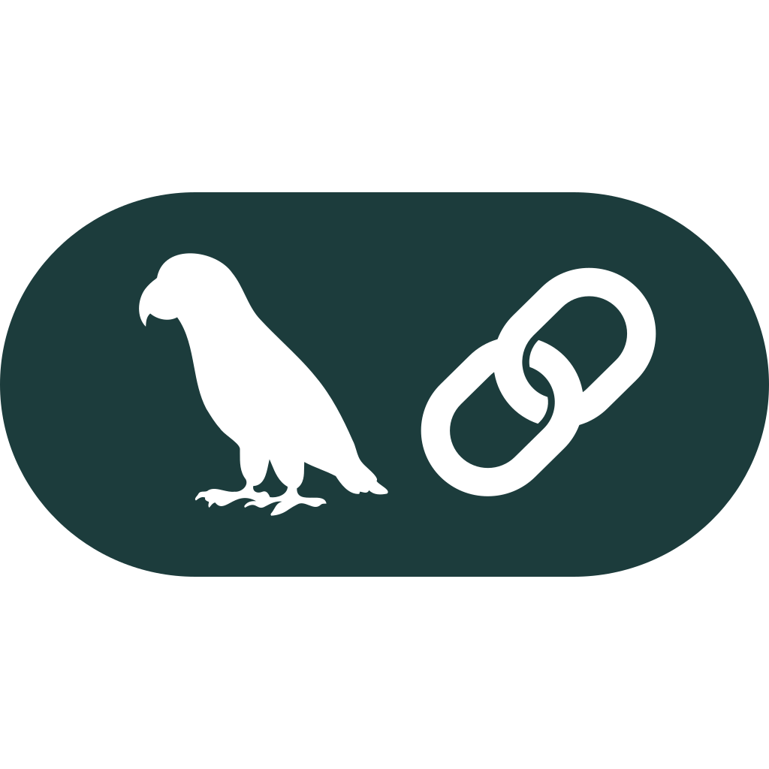
Infosys Slide Diagram
Azure Build Diagram
CI/CD
Zara LM Source Code
Application
Azure Virtual Networks and Subnets
DevOps
Version Control & Deployment
Cosmos DB using MongoDB vCore
Vector Database
Bicep Template
Infrastructure as Code
Azure Kubernetes
Container Orchestration for Scaling
Python with
Azure CLI
Docker Container
Static Web Apps
Frontend Deployment w/ Node.js and React
Azure Container Registry
Storing Docker Images
Azure Functions
All API endpoints
Ollama
LLM & Embedding Models
Entra ID
Authentication
Blob Storage
Document Storage
Blob Storage
Metadata Storage
User Uploads Document
Infosys Plugin
Containerised?
Plugin Framework
DevOps
Code Deployment
Azure OpenAI LLMs
Vector Database
Four Agent Use Case with LangGraph

